Slide 1
Predicting Toxicity with the Tox21 Data Set

Slide 2

The Tox21 Data Set
The Tox21 Consortium originated in 2008 and involves several governmental agencies (EPA, NIH, FDA, NTP).
Goals include “developing methods to rapidly and efficiently evaluate the safety of commercial chemicals, pesticides, food additives/contaminants, and medical products.”
Tox21 has performed ~70 high-throughput assays for thousands of compounds, gathering ~120 million data points.
In this workshop, we will use a subset of the publicly available data to predict the toxicity of compounds based on their chemical structure.
https://tox21.gov/wp-content/uploads/2021/03/Tox21_FactSheet_Mar2021.pdf

Slide 3
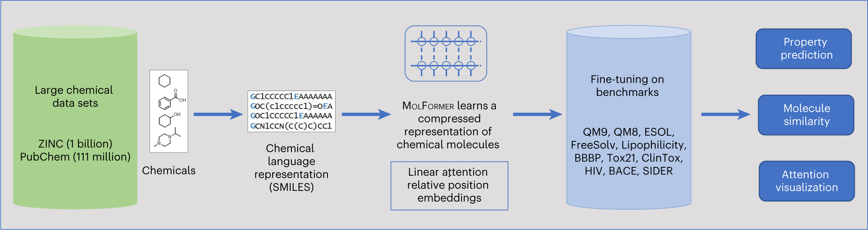
Converting Chemical Structures to Numerical Features
Chemical structures
String representation
(chemical “language”)
Large Language Model outputs vectors from strings
Additional data/labels
Downstream tasks/models
Ross, Jerret, et al. "Large-scale chemical language representations capture molecular structure and properties." Nature Machine Intelligence 4.12 (2022): 1256-1264.

Slide 4
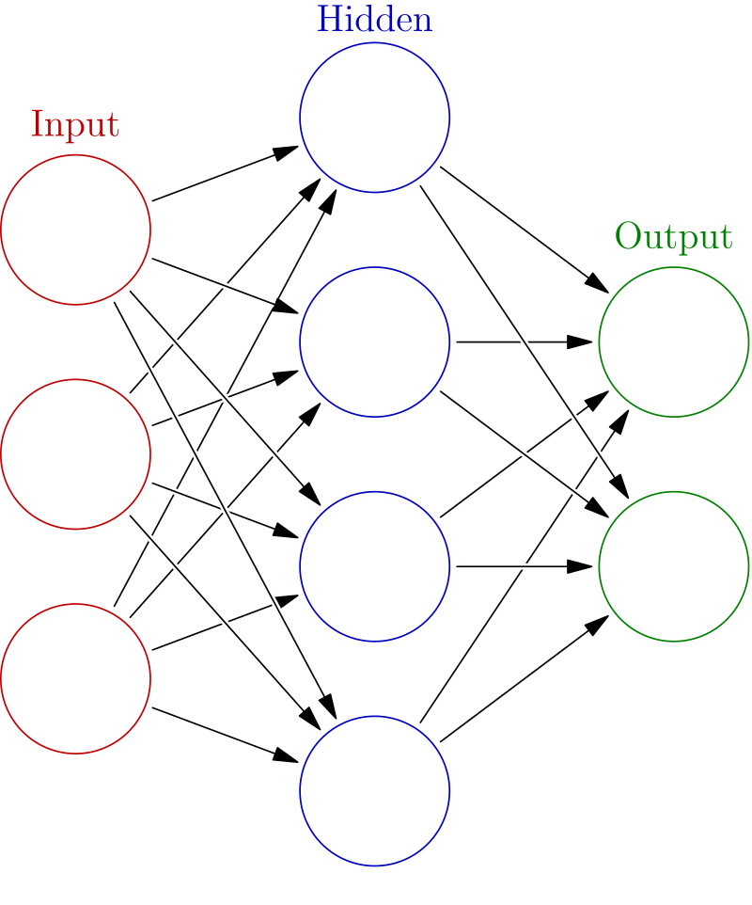
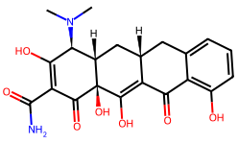

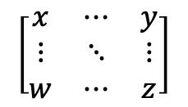
Classification: Training
COMPOUND
MolFormer (fixed)
$$\left[\begin{matrix}x & ⋯ & y \\ ⋮ & ⋱ & ⋮ \\ w & ⋯ & z\end{matrix}\right]$$
Multilayer Perceptron (trainable)
+
LABEL
(1=toxic, 0=nontoxic)
OUTPUT
(1=toxic, 0=nontoxic)
Compare
Update weights
(backpropagation)
Error (loss)

Slide 5
Classification: Inference/Prediction
COMPOUND
MolFormer (fixed)
$$\left[\begin{matrix}x & ⋯ & y \\ ⋮ & ⋱ & ⋮ \\ w & ⋯ & z\end{matrix}\right]$$
Multilayer Perceptron (fixed)
+
LABEL
(UNKNOWN)
OUTPUT
(1=toxic, 0=nontoxic)
Annotate

